Slide 1


Computer
Lecture 10
Dr. Nada Abdullah Rasheed
Assist prof. / Computer Science

Slide 2
Syllabus Content
Subject | Lec. No.
Convert Decimal to Binary & Binary to Decimal Numbers Systems | 3
Convert Decimal to Binary System | 3
Binary Numeral Numbers | 8

Slide 3
Convert Decimal to Binary & Binary to Decimal Numbers Systems
Convert Decimal to Binary System
Step 1 - Divide the decimal number to be converted by the value of the new base.
Step 2 - Get the remainder from Step 1 as the rightmost digit (least significant digit) of the new base number.
Step 3 - Divide the quotient of the previous divide by the new base.
Step 4 - Record the remainder from Step 3 as the next digit (to the left) of the new base number.
Repeat Steps 3 and 4, getting reminders from right to left, until the quotient becomes zero in Step 3.

Slide 4
Example-2-
Decimal Number: 29₁₀
Calculating Binary Equivalent:
Step | Operation | Result | Remainder
Step 1 | 29 / 2 | 14 | 1
Step 2 | 14 / 2 | 7 | 0
Step 3 | 7 / 2 | 3 | 1
Step 4 | 3 / 2 | 1 | 1
Step 5 | 1 / 2 | 0 | 1

Slide 5
As mentioned in Steps 2 and 4, the remainders have to be arranged in the reverse order so that the first remainder becomes the Least Significant Digit (LSD) and the last remainder becomes the Most Significant Digit (MSD).
Decimal Number:
29₁₀ = Binary Number: 11101₂

Slide 6
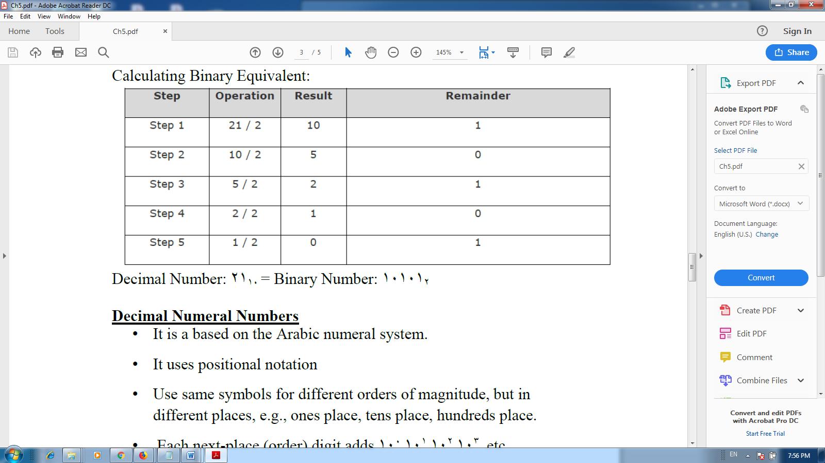
Example-3-
Decimal Number: 21₁₀
Calculating Binary Equivalent:

Slide 7
Decimal Number: 21₁₀ = Binary Number: 10101₂
Decimal Numeral Numbers
• It is a based on the Arabic numeral system.
• It uses positional notation
• Use same symbols for different orders of magnitude, but in different places, e.g., ones place, tens place, hundreds place.
• Each next-place (order) digit adds 10⁰,10¹,10²,10³, etc.
• Example: In decimal, 1472 means
2 - is in the ones place so multiply it by 10⁰ (1) = 2
7 - is in the tens place so multiply it by 10¹ (10) =70
4 - is in the one-hundred place so multiply it by10²(100) =400
1 - is in the one-thousands place so multiply it by 10³ (1000) =1000
1000+400+70+2=1472

Slide 8
Binary Numeral Numbers
• It is a based on the binary representation (0, 1).
• It also uses the positional notation
• Use the same symbols for different orders of magnitude, but in different places, e.g., ones place, twos place, fours place.
• Each next-place (order) digit adds 2⁰,2¹,2²,2³, etc.
• Example: In binary, 1101 means.
1 - is in the ones place so multiply it by 2⁰ (1) = 1
0 - is in the twos place so multiply it by 2¹ (2) = 0
1 - is in the fours place so multiply it by 2² (4) = 4
1 - is in the eights place so multiply it by 2³ (8) =8
=> 8+4+0+1 = 13
Binary 1101 = Decimal 13
1101 B = 13 D

Slide 9
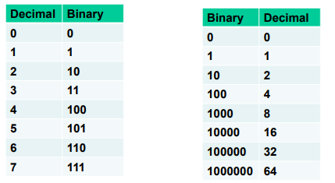
For an 8-bit binary, what is the largest number in decimal? Binary 11111111 = ?
Division by 2 with remainder.
Dividing each new quotient by two and writing the remainders to the right of each dividend. Stop when the quotient is 0.
Starting with the bottom remainder, read the sequence of remainders upwards to the top.

Slide 10
Exp: what is decimal 13 in binary?
2)13 1
2) 6 0
2) 3 1
2) 1 1
0
The answer: 1101

